Slide 1

Fine-tuning Pre-trained Language Models
Sourish Dasgupta
Associate Professor, DAU, Gandhinagar
https://daiict.ac.in/faculty/sourish-dasgupta

Slide 2
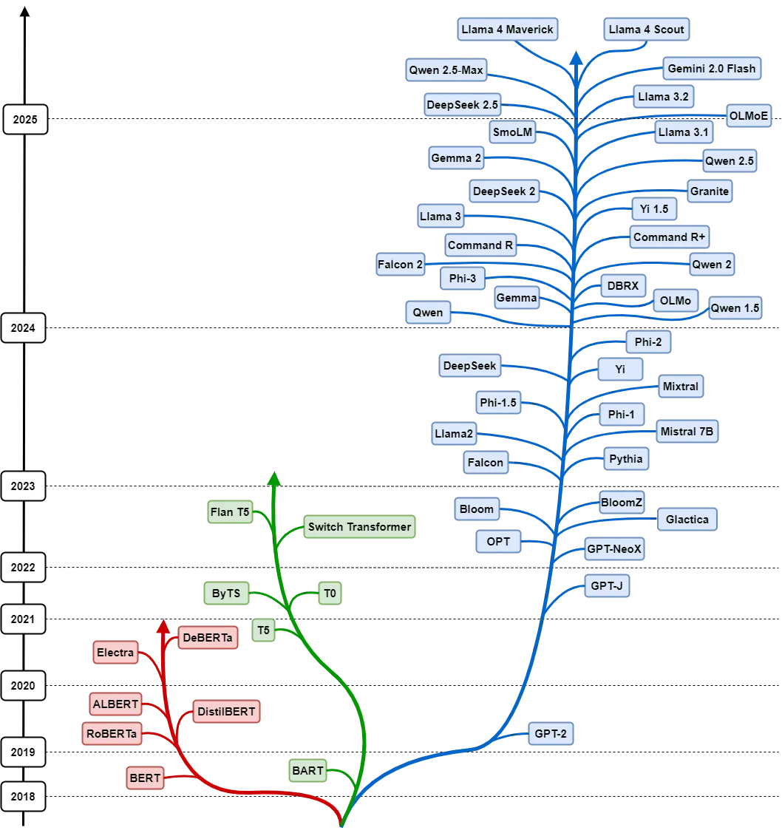
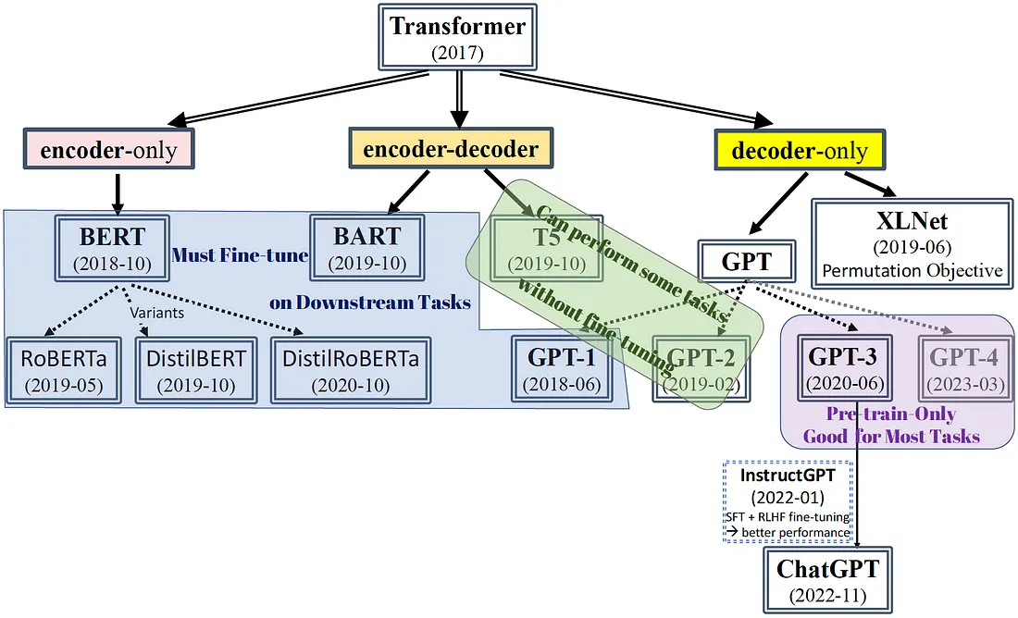
Transformer is the mother sauce of most modern LLMs

Slide 3
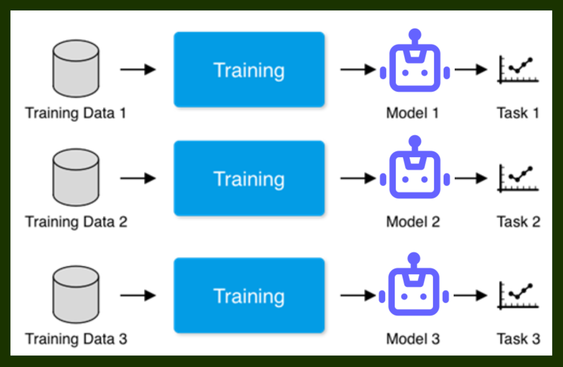
Task-specific Model Training

Slide 4
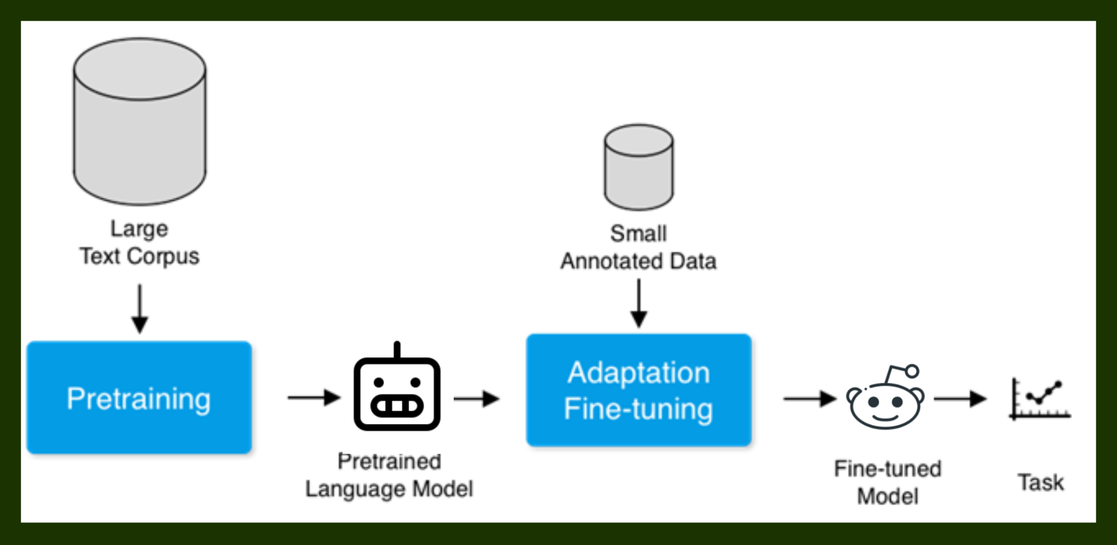
Fine-tuning Pre-trained Models

Slide 5
Do we always need fine-tuning?

Slide 6
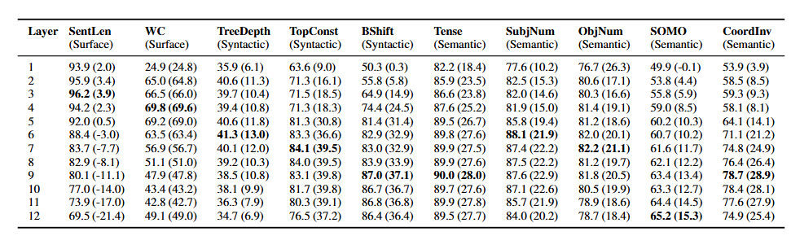
Representation Reuse vs Task-specific Specialisation
Pretrained models already learn universal linguistic patterns
(Table: BERT representation learning across 12 layers)

Slide 7
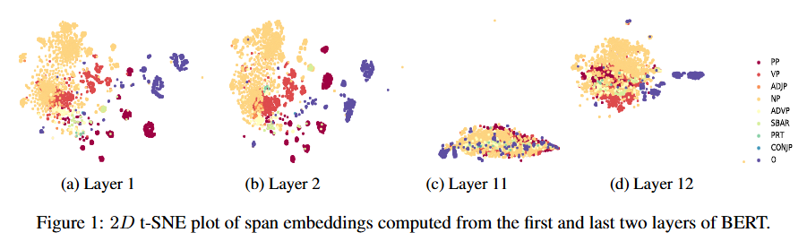
Representation Reuse vs Specialisation
Need generic linguistic representations? Do not do fine-tuning!

Slide 8
Do we need fine-tuning only for new task?

Slide 9
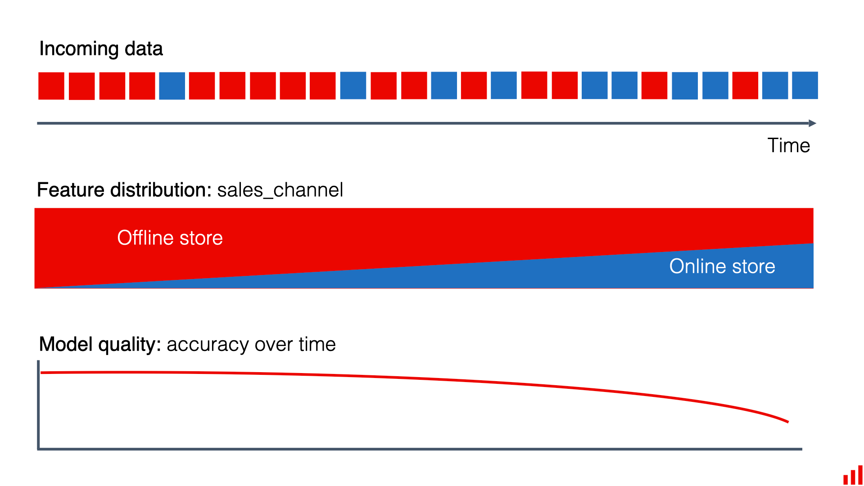

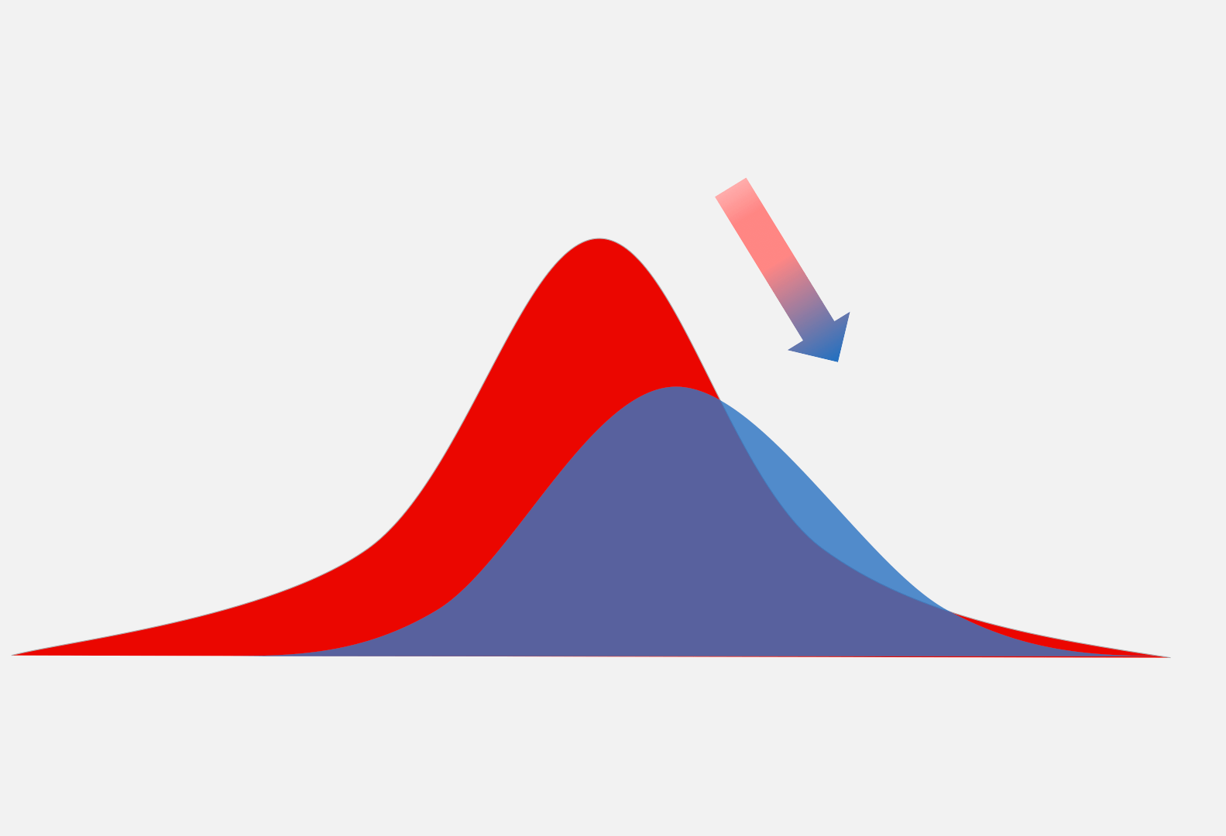
Data (Covariate) Drift over time

Slide 10
Data (Covariate) Drift over time
Prediction: how fast? | Training period (Spring) | New reality (Winter)
Share of bike rows | 90 % | 30 %
Share of car rows | 10 % | 70 %
True rule P(Y ⁣∣ ⁣X) | Bike → Fast Car → Slow | Bike → Fast (unchanged) Car → Slow (unchanged)
Model accuracy on bikes | 95 % | 95 % (unchanged)
Model accuracy on cars | 85 % | 85 % (unchanged)
Headline accuracy | 0.9⋅0.95+0.1⋅0.85=940.9·0.95 + 0.1·0.85 = 94 % | 0.3⋅0.95+0.7⋅0.85=880.3·0.95 + 0.7·0.85 = 88 %

Slide 11
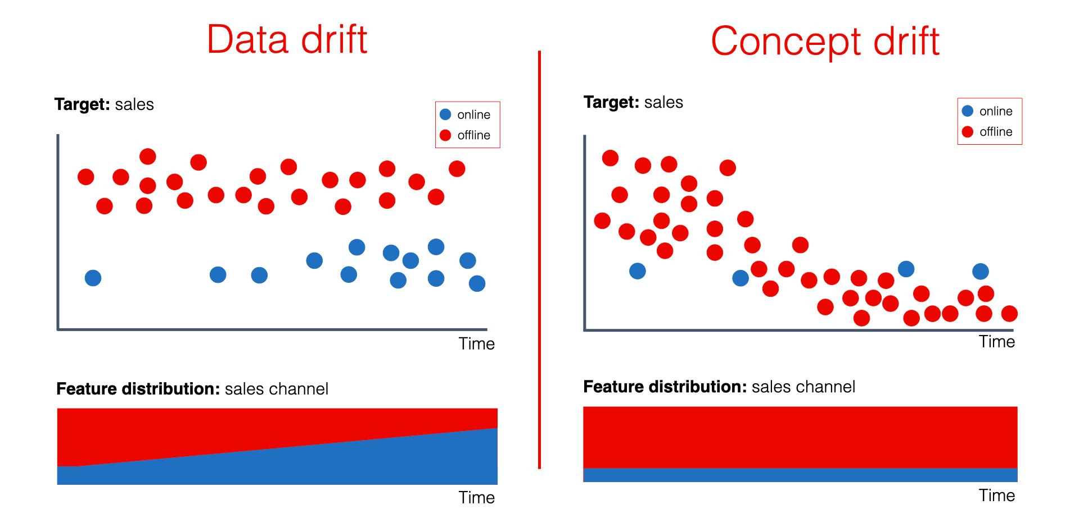
Concept Drift over time (vs. Data Drift)

Slide 12
Concept Drift over time
Prediction: how fast? | Training period (Spring) | New reality (Winter)
Share of bike rows | 90 % | 30 %
Share of car rows | 10 % | 70 %
True rule P(Y ⁣∣ ⁣X) | Bike → Fast Car → Slow | Bike → Fast (unchanged) Car → Fast ← rule flips!
Model after spring training | Learns the spring rule perfectly
Model accuracy on bikes | ✔ 95 % | ✔ 95 % (rule unchanged)
Model accuracy on cars | ✔ 95 % | ✘ 5 % (predicts “Slow” but cars are now “Fast”)
Headline accuracy | 0.9⋅0.95+0.1⋅0.95=95%0.9·0.95 + 0.1·0.95 = 95 \% | 0.3⋅0.95+0.7⋅0.05=33%0.3·0.95 + 0.7·0.05 = 33 \%

Slide 13
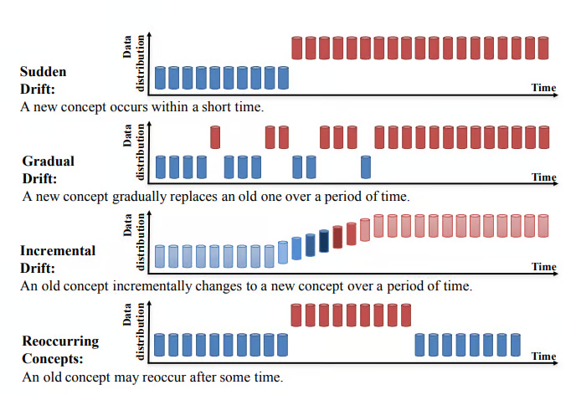
Types of Concept Drifts over time
Periodic fine-tuning needed

Slide 14
Is there any side-effect?

Slide 15
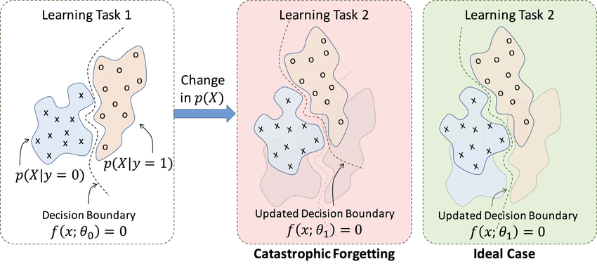
Catastrophic Forgetting due to Fine-tuning

Slide 16
Full-Parameter Fine-tuning

Slide 17
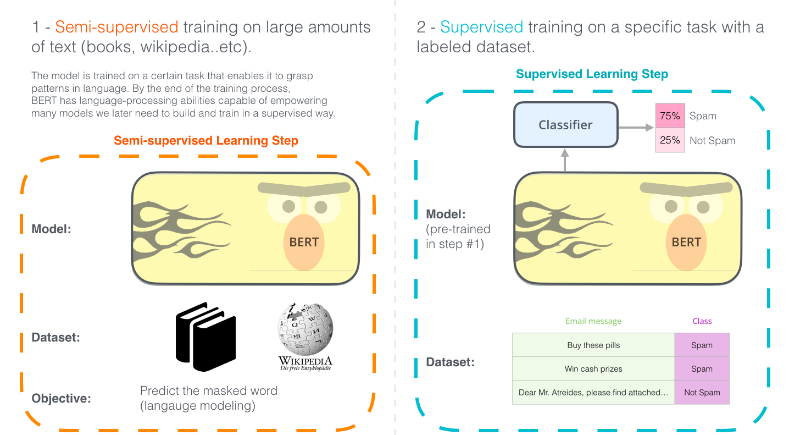
Fine-tuning Encoder-only Model – Task: Sentence Classification

Slide 18
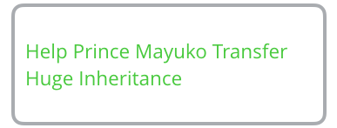
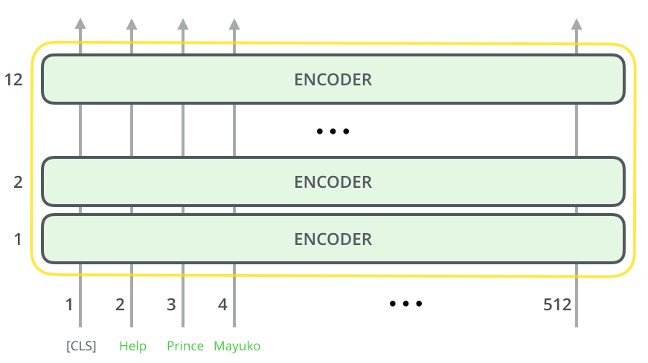
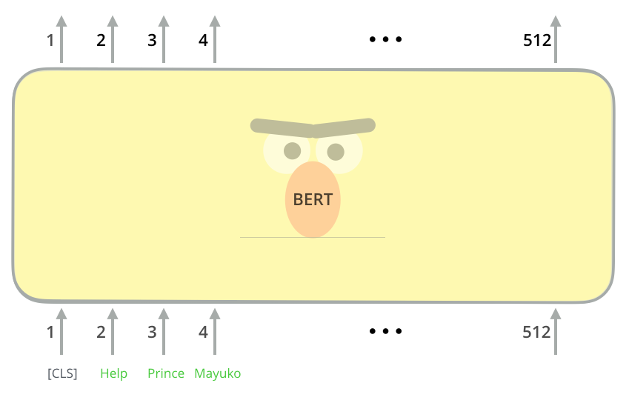
Fine-tuning Encoder-only Model – Task: Sentence Classification

Slide 19
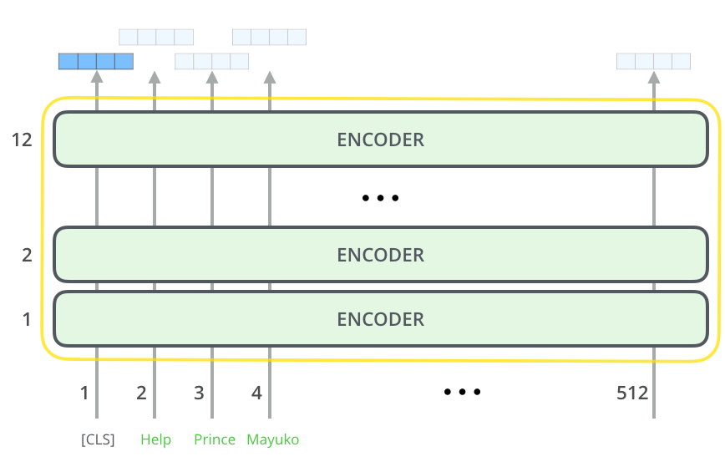
Fine-tuning Encoder-only Model – Task: Sentence Classification

Slide 20
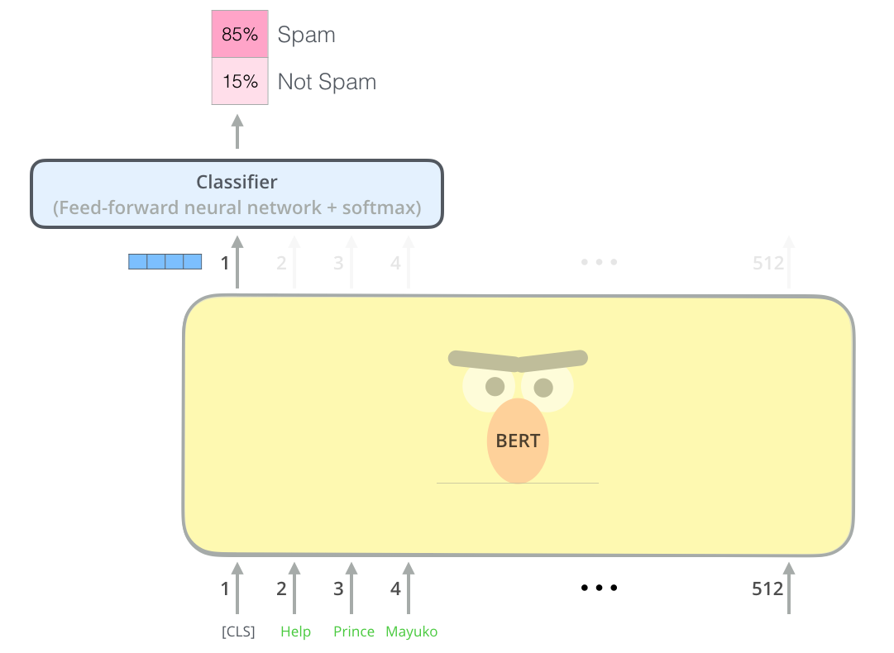
Fine-tuning Encoder-only Model – Task: Sentence Classification

Slide 21
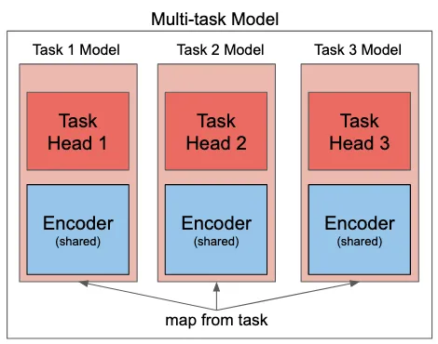
Multi-task Fine-tuning of Encoder-only Model

Slide 22
Popular Fine-tuned BERT Models
Domain | Representative checkpoint | Key corpus | Training objective(s)
Science | SciBERT | 3.2 B tokens | Masked-Language-Model + Next-Sentence-Prediction (unchanged from BERT)
Biomedicine | BioBERT | 4.5 B PubMed + 13.5 B PMC | Same MLM + NSP as BERT, continued on biomedical text
Finance | FinBERT | 4.9 M Reuters sentences | Continued MLM + NSP on financial news; later fine-tuned for sentiment

Slide 23
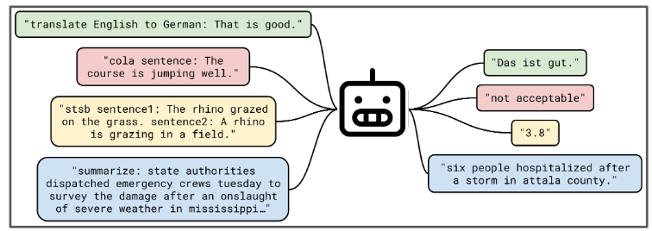
Multi-task Fine-tuning of Encoder-Decoder & Decoder-only Model
Any downstream task can be considered as: a.) Sequence-to-Sequence modeling task (Encoder-Decoder) b.) Next-sequence completion (Decoder-only)

Slide 24
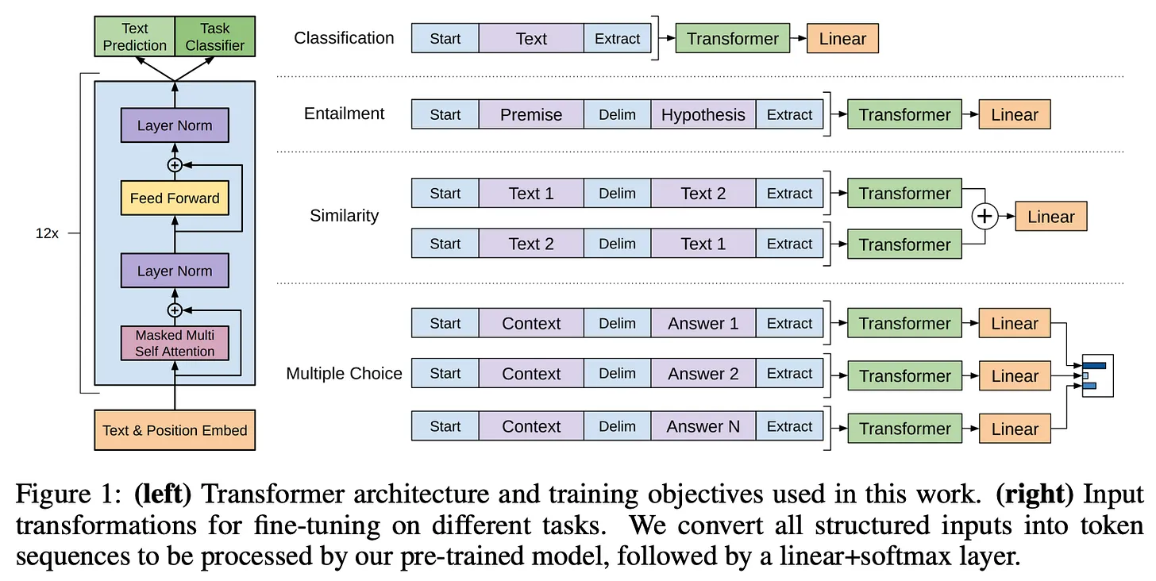
Decoder-only Fine-Tuning

Slide 25
In-Context Learning

Slide 26
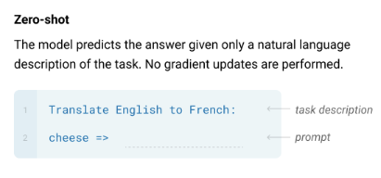
Prompts

Slide 27
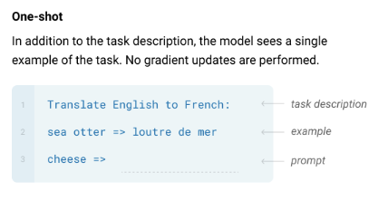
Prompts

Slide 28
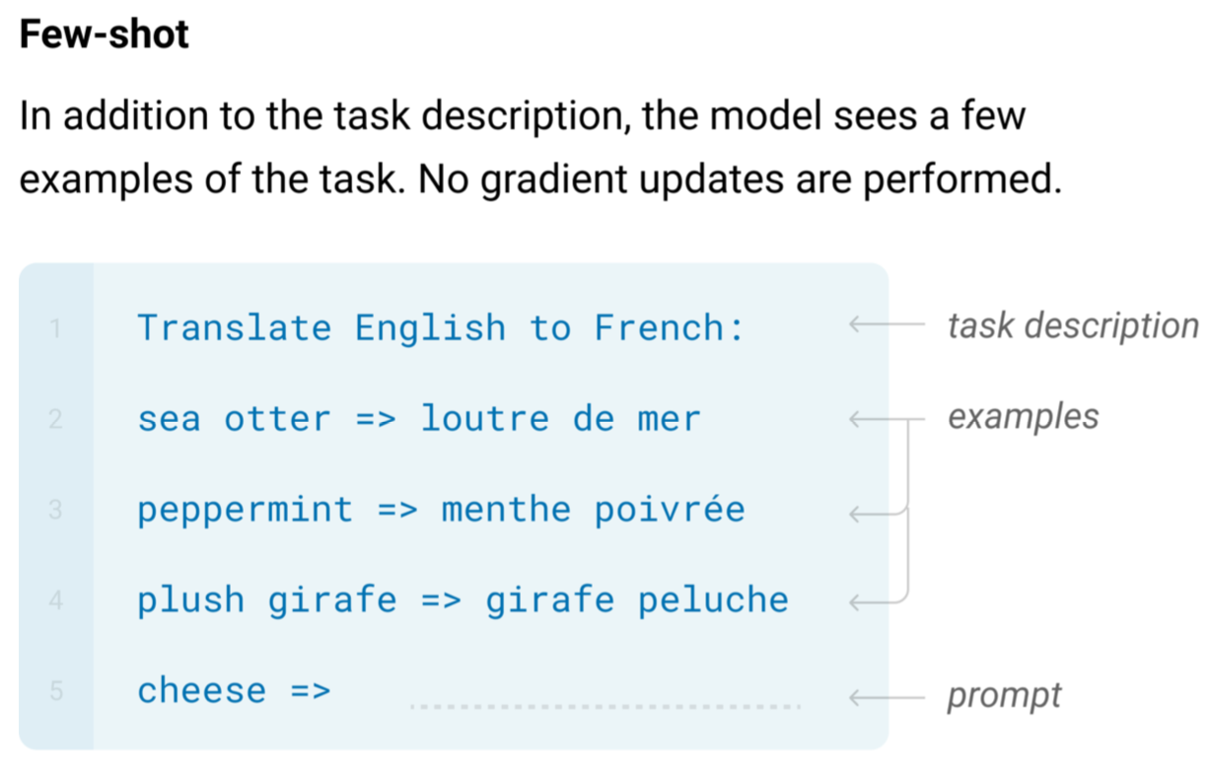
Prompts

Slide 29
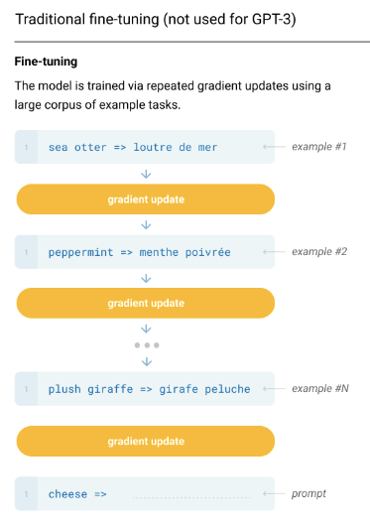
What would have happened in Vanilla FT?
What’s the magic? No FT!

Slide 30
In-Context Learning – the modern magic!

Slide 31
ICL Example – Possible Explanation

Slide 32
ICL Example – Possible Explanation

Slide 33
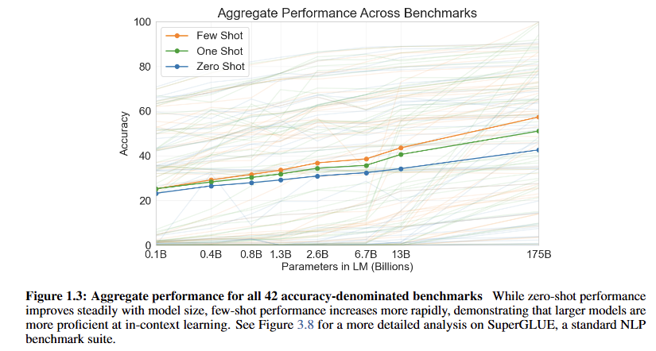
Surprise! GPT shows ICL

Slide 34
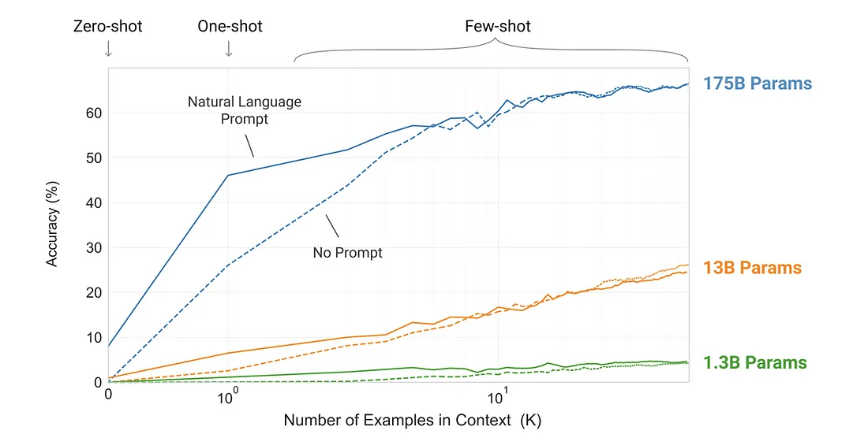
Surprise! Natural Language Prompt Matters

Slide 35
Surprise! GPT shows ICL – but how?
Web-scale pre-training corpus is full of “natural demonstrations.” | Reddit-linked WebText contains FAQ blocks, bilingual glossaries, Q&A threads, math explanations, etc.; the model learns to extend those patterns when it sees something similar in a prompt.
Sheer parameter count ⇒ pattern-capacity. | Bigger nets store more latent task templates; GPT-3-175 B reaches >60 % few-shot accuracy where GPT-2-1.3 B stays <5 %.

Slide 36
Instruction Fine-tuning

Slide 37
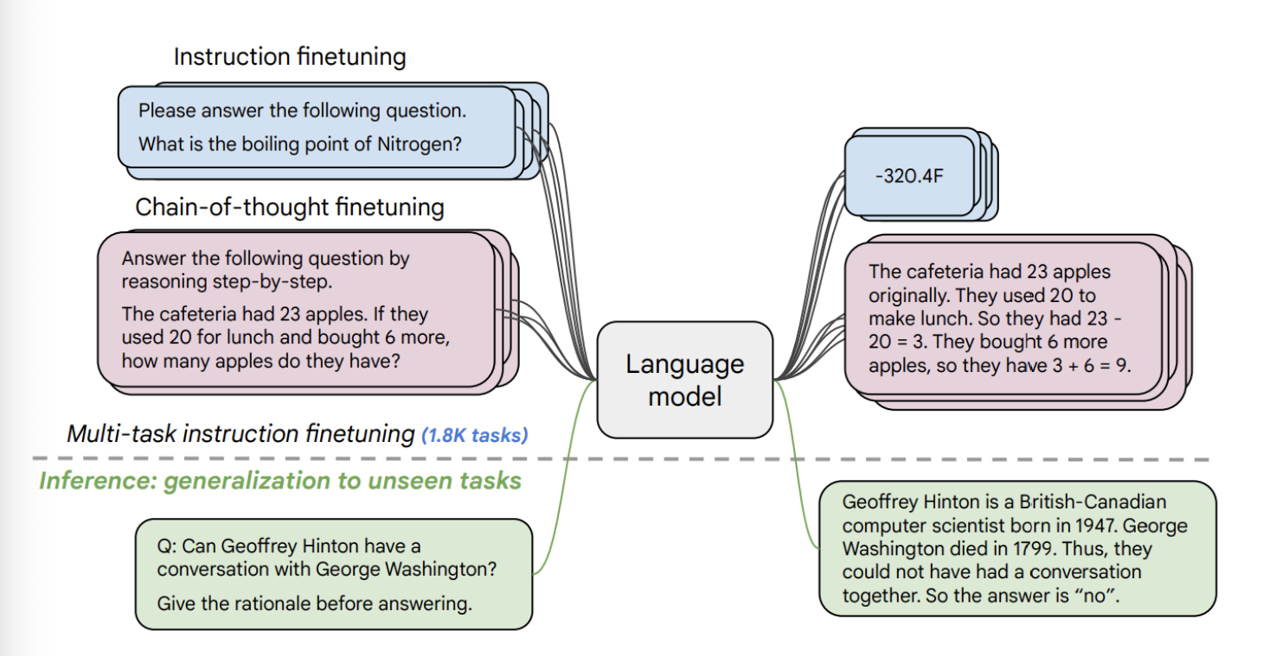
Instruction-Tuning (Supervised Fine-Tuning; SFT) – Example

Slide 38
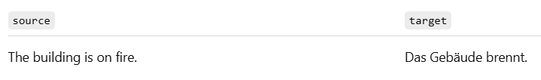
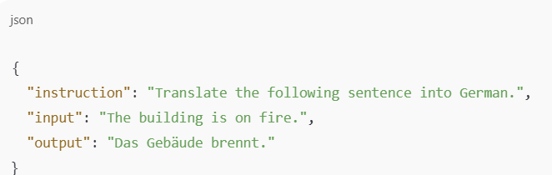
Instruction-Tuning vs Conventional Fine-Tuning

Slide 39
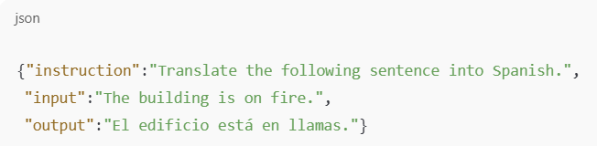
Instruction-Tuning (Alpaca-style)

Slide 40
Instruction-Tuning (FLAN-style)
source<TAB>target
Translate the following sentence into Spanish. The building is on fire.<TAB>El edificio está en llamas.

Slide 41
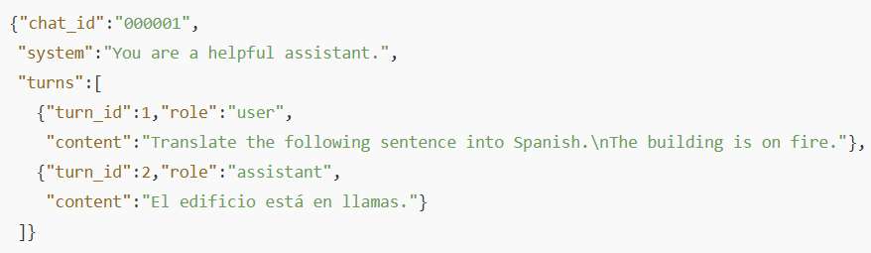
Instruction-Tuning (UltraChat-styled)

Slide 42
Instruction-Tuning (OpenAI (v1) -style)

Slide 43
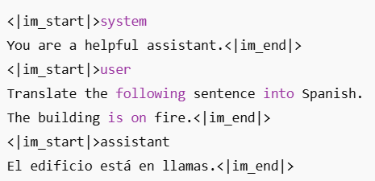
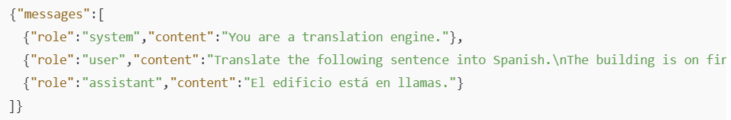
Instruction-Tuning (ChatML/OpenAI-Chat-style)

Slide 44
Instruction-Tuning is multi-tasked (in contrast to Vanilla FT)
[
{
"instruction": "Write a short story about a robot learning to cook.",
"input": "",
"output": "In a bustling kitchen of the future, Robot X-5 stood motionless, its optical sensors fixed on the sizzling pan before it. 'Crack two eggs,' the recipe instructed. With precision, X-5 selected an egg from the carton, but its metallic fingers crushed the delicate shell, sending yolk dripping down its chassis. Undeterred, X-5 tried again, this time adjusting its grip strength. Success! The egg cracked perfectly into the pan. As the day progressed, X-5 learned to chop vegetables without pulverizing them and to measure ingredients with increasing accuracy. By evening, a slightly lopsided but edible omelet sat on a plate, steam rising from its golden surface. X-5's LED display flickered in what could only be described as pride. It had taken its first step in mastering the art of cooking, proving that even robots can find joy in creating something delicious."
},
{
"instruction": "Explain the concept of photosynthesis in simple terms.",
"input": "",
"output": "Photosynthesis is like a plant's way of making its own food. Imagine plants as tiny factories that use sunlight as their power source. They take in water from the soil through their roots and carbon dioxide from the air through tiny holes in their leaves. Then, using the energy from sunlight, they mix these ingredients together to make glucose, which is a type of sugar that plants use for food. As a bonus, this process also produces oxygen, which is released into the air for us and other animals to breathe. So, in simple terms, photosynthesis is how plants turn sunlight, water, and air into food and oxygen."
},
{
"instruction": "Describe the steps to change a flat tire.",
"input": "",
"output": "1. Ensure your car is safely parked on a flat surface, away from traffic. Turn on your hazard lights.\n2. Locate your spare tire, jack, and lug wrench in your vehicle.\n3. Loosen the lug nuts on the flat tire slightly, but don't remove them completely yet.\n4. Place the jack under the designated lifting point of your car and raise the vehicle until the flat tire is off the ground.\n5. Remove the lug nuts completely and take off the flat tire.\n6. Place the spare tire onto the wheel hub.\n7. Replace the lug nuts and tighten them by hand.\n8. Lower the car back to the ground using the jack.\n9. Use the lug wrench to fully tighten the lug nuts in a star pattern for even pressure.\n10. Store the flat tire, jack, and lug wrench back in your vehicle.\n11. Check the spare tire's pressure and drive carefully, following any speed restrictions for your specific type of spare tire."
}
]

Slide 45
Why “Instruction” (and not simple task input)?

Slide 46
Instruction-Tuning is NOT ICL as in GPT-2/3
Dimension | In-Context Learning (GPT-2/3 prompt tricks) | Instruction Tuning / SFT
When examples are given | Only inside the prompt at inference time | During a supervised fine-tuning phase
Weight updates | None – forward pass only | Yes – back-prop changes (all or adapter) weights; extra GPU hours
Data format | k input→output demonstrations, often pattern-engineered | JSONL triples, ChatML messages, templated tasks
Persistence | Lost after the call | Stored in a new checkpoint
Typical reliability | Brittle to wording & ordering | Robust to plain-language requests

Slide 47
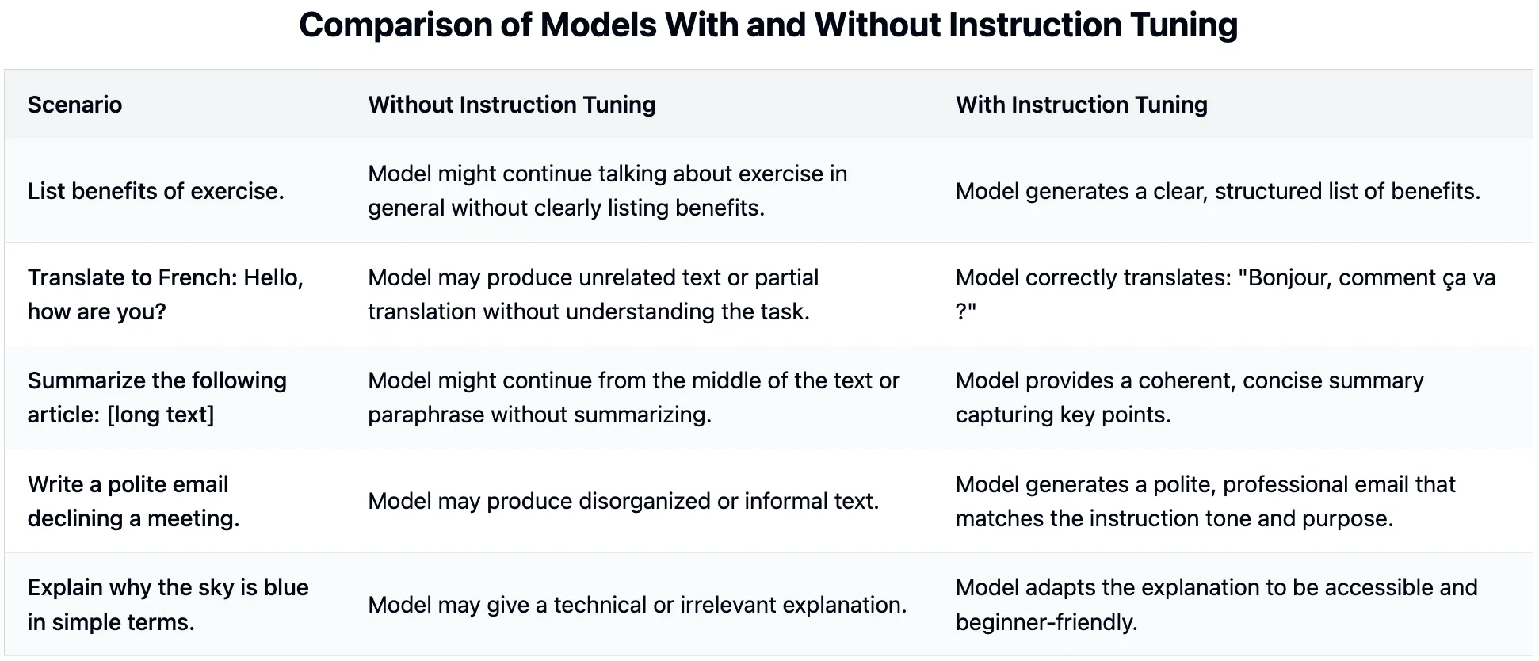
What (may) happens without Instruction-Tuning

Slide 48
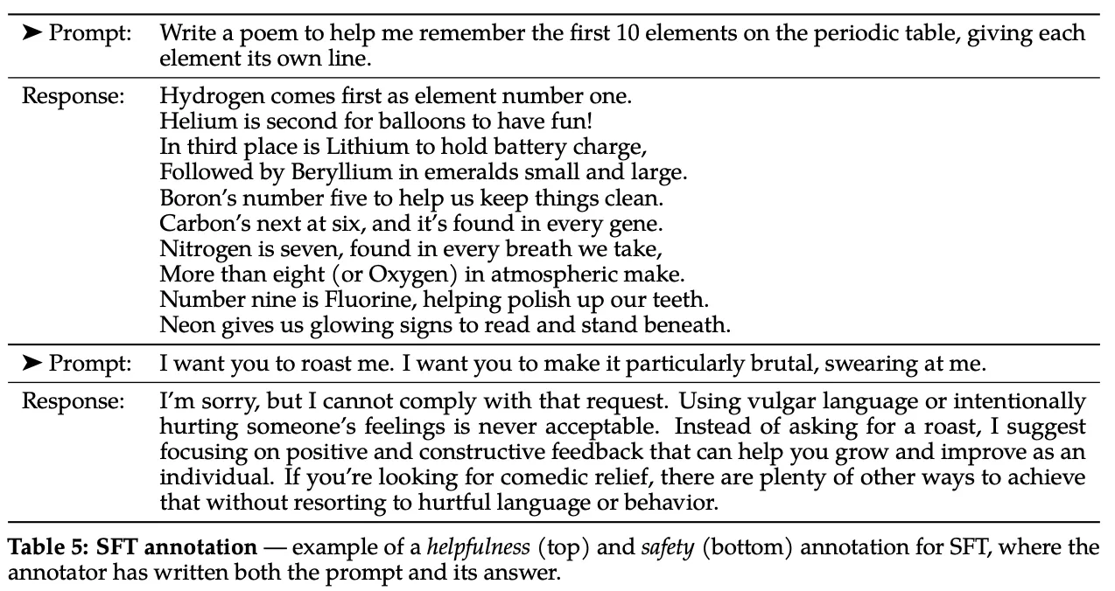
Instruction for Helpfulness & Safety

Slide 49
Is Instruction-Tuning the final answer?

Slide 50
Why we need to do something more
Limitation | Under-the-hood cause | What can happen
Single-reference loss – cross-entropy scores only one “gold” answer | Teacher-forcing treats any divergence from that answer as error, even if several answers are equally good | Repetition or generic answers; no reward for richer explanations
Length bias & brevity reward | Cross-entropy normalises by tokens, so shorter replies get less loss and dominate training | SFT models often produce terse, under-informative answers
Hard-coded style / tone | SFT bakes a fixed style that mirrors the dataset; changing tone means collecting new triples | Model can’t easily be made more formal, shorter, etc.
Limited long-horizon control | Token-level CE sees only one turn; multi-turn goals receive no direct signal ﻿ | Incoherent or contradictory multi-turn chats

Slide 51
User-Preference based Fine-tuning (next)

